Slide 1

Introduction to MongoDB
STAT 474 – Techniques for Large Data Set
Notes:
Are your classroom colors different than what you see in this template? That’s OK! Click on Design -> Variants (the down arrow) -> Pick the color scheme that works for you!
Feel free to change any “You will…” and “I will…” statements to ensure they align with your classroom procedures and rules!

Slide 2
What is MongoDB?
MongoDB is the most popular NoSQL database system
Document-oriented database
Use JSON-like documents with “schemas”
Free, open-source, and cross-platform database system
You can download and install on your machine. https://docs.mongodb.com/manual/installation/
Several R packages have been created to interact with MongoDB. A fast and simple one is mongolite
R does not support document data structure; extracted data will be converted to data.frame or list

Slide 3
How are data organized in MongoDB
MongoDB is made up of databases which contain collections.
A collection is made up of documents.
Each document is made up of fields.
Collections can be indexed, which improves lookup and sorting performance.
Relational Concepts | MongoDB Equivalent
Database | Database
Table | Collection
Rows (Records) | Documents
Index | Index

Slide 4
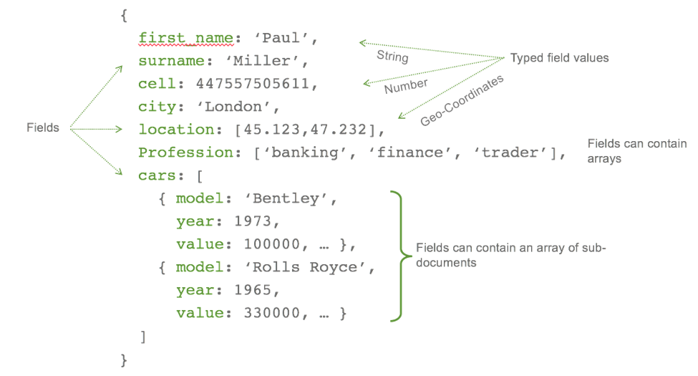
Example of a Document

Slide 5
Documents in MongoDB
Inspired by JSON specification (http://www.json.org/)
Basic structure: a pair of key-value (a.k.a. field-value) in form of {string : value}, key in form of string
Values in field-value pairs can be geospatial, Date, arrays, subdocuments, etc.
Arrays in form: [string1 : value1, string2 : value2, ...., string_k:value_k]
Subdocuments: surrounding by {....}
JSON-type is text-based. MongoDB also support binary-encoded JSON format, called BSON

Slide 6
Documents in MongoDB

Slide 7
Demo in MongoDB shell & In-class Activities

